Slide 1

Basic Details of the Team and Problem Statement
Ministry/Organization Name/Student Innovation: International Council for Circular Economy (ICCE).
PS Code: SG867
Problem Statement Title: Tracking of food waste for productive usage
Team Name: Food{Hacker}
Team Leader Name: Parth Bansal
Institute Code (AISHE): U-0497
Institute Name: Amity University Noida
Theme Name: Miscellaneous

Slide 2
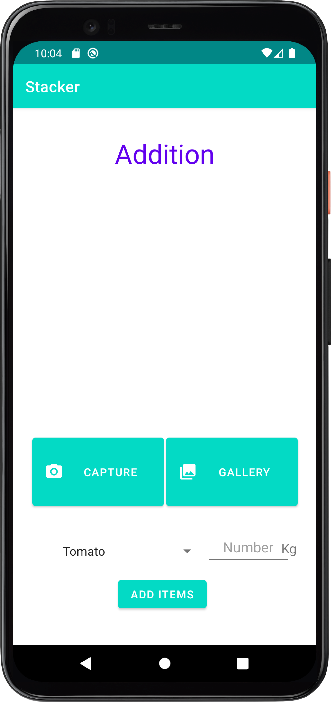
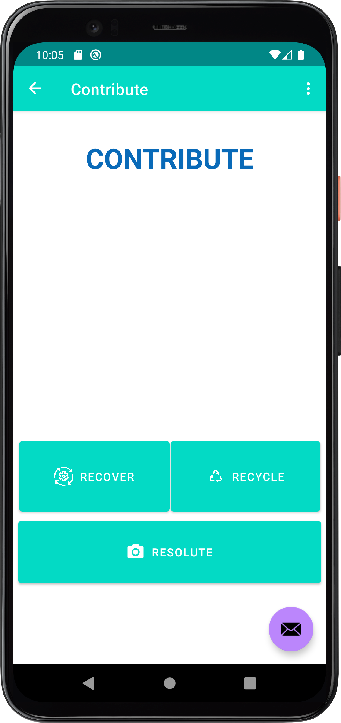
Idea/Approach Details
Describe your idea/Solution/Prototype here:
As we all know that we waste a large amount of food everyday that is in good condition, which can be recycled or reused.
So we have developed an app using which a person can send the pictures of there waste food so that it can be given to people in need or can be used as manure.
The person can simply click the photo of the food item and our volunteer will take that food and reuse or recycle that item defending upon its condition.
Describe your Technology stack here:
Technologies we used to develop the application:
Google Maps
DBMS (Sqlite)
Sockets
Multithreading
Hashing & Async Encryption algo
Diffe hellman key exchange
Tensorflow
JSON

Slide 3
Idea/Approach Details
Describe your Use Cases here
Describe your Dependencies / Show stopper here
Home → So this is our home page on this page the customer can either add an image of the food item or review the items that are already present in the gallery.
Dropzone→ When you click this button, a map will open and all the closest dropzones from your location can be viewed. You can deliver the leftover food items to the nearest dropzone.
Goal → After clicking this button you can see all the goals and challenges region-wise and you can be a part of something big and contribute to betterment of the society.

Slide 4
Team Member Details
Team Leader Name: Parth Bansal
Branch: B-tech Stream : CSE Year : 2
Team Member 1 Name: Deepanhu
Branch: B-tech Stream : CSE Year : 2
Team Member 2 Name: Aditya Kuman Yadav
Branch: B-tech Stream : CSE Year : 2
Team Member 3 Name: Nibir Maram Deka
Branch: B-tech Stream : CSE Year : 2
Team Member 4 Name: Neha Goyal
Branch: B-tech Stream : CSE Year : 2
Team Member 5 Name: Aditya Rajput
Branch: B-tech Stream : CSE Year : 2
Team Mentor 1 Name: Type Your Name Here
Category (Academic/Industry): Expertise (AI/ML/Blockchain etc): Domain Experience (in years):
Team Mentor 2 Name: Type Your Name Here
Category (Academic/Industry): Expertise (AI/ML/Blockchain etc): Domain Experience (in years):

Slide 5
Important Pointers
Please ensure below pointers are met while
Kindly keep the maximum slides limit to 4 pages
All the topics should be utilized for description of your idea
Try to avoid paragraphs and post your idea in points
Keep your explanation precisely and easy to understand
Idea should be unique and novel. If it has a business potential more weightage will be given.
Apart from this PPT abstract of your idea will be asked separately while submitting
You need to save the file in PDF and upload the same on portal. No PPT, Word Doc or any other format will be supported
You can delete this slide (Important Pointers) when you upload the details of your idea on SIH portal.

